Slide 1









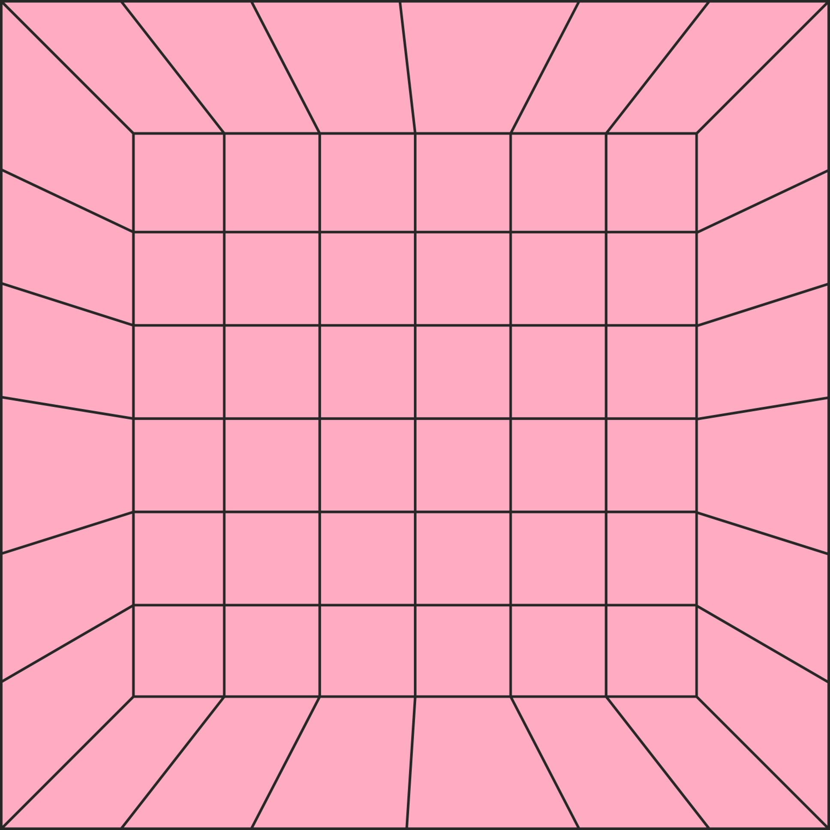







MAZE GAME
SRS
System Requirement Specification

Slide 2
MAZE GAME
SRS
System Requirement Specification

Slide 3
MAZE GAME
SRS
System Requirement Specification

Slide 4

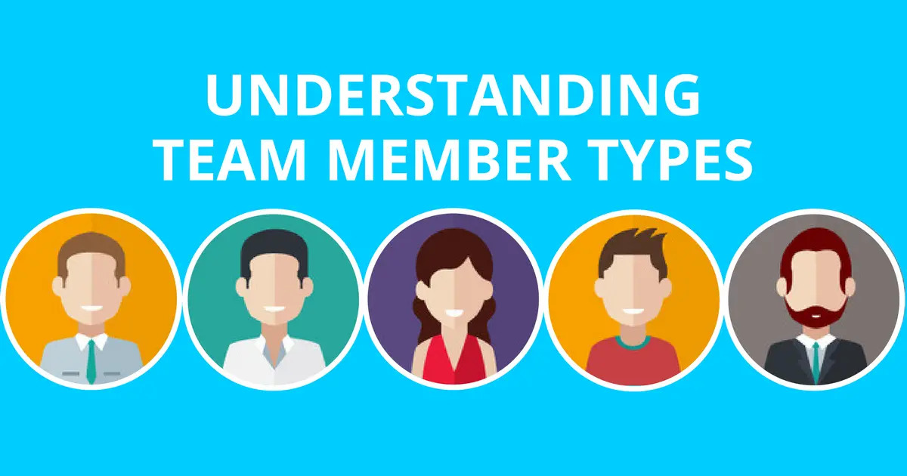
MAZE GAME
SRS
System Requirement Specification
Team Introduction
Team Supervisor
Sir Uzair Saeed
M Awais Akhter (Team Leader)
BSSE-Fa20-029
Muneeb Rafi
BSSE-Fa20-031
Adul Basit
BSSE-Fa20-008

Slide 5
MAZE GAME
SRS
Team Introduction
System Requirement Specification
Team Supervisor
Sir Uzair Saeed
M Awais Akhter (Team Leader)
BSSE-Fa20-029
Muneeb Rafi
BSSE-Fa20-031
Adul Basit
BSSE-Fa20-008

Slide 6

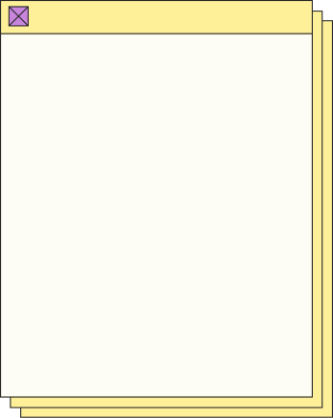
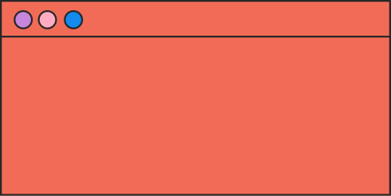


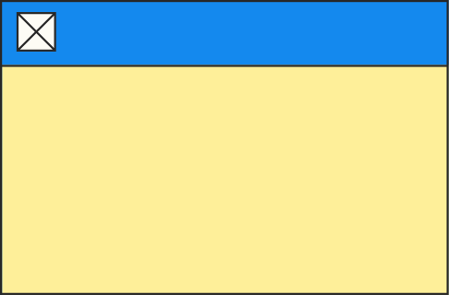

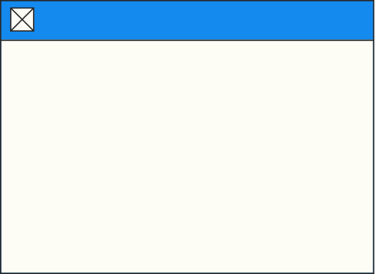
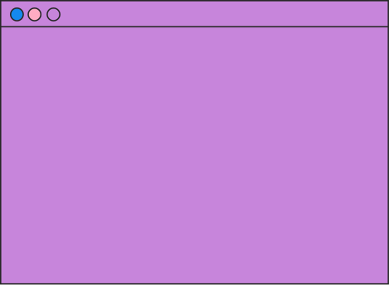
PROJECT INTRODUCTION
SRS
MAZE GAME
BUSINESS PLAN
REQUIREMENTS ANALYSIS
USE CASE DIAGRAMS

Slide 7
PROJECT INTRODUCTION
PROJECT INTRODUCTION
Our project is a First-Person Maze Puzzle Game.
It is a genre-changing puzzle game, with the potential to attract a vast player base.
The puzzle genre not only entertains but also enhances users' cognitive skills, develops logical thinking and problem-solving abilities.
The game will captivate players throughout their gaming journey.
SRS
MAZE GAME
BUSINESS PLAN
REQUIREMENTS ANALYSIS
USE CASE DIAGRAMS

Slide 8
Aims & Objectives
PROJECT INTRODUCTION
Improve Brain Activity
Improve User Problem-Solving Skills, Cognitive Thinking and Logical Thinking.
Genre Bending Gameplay
Improve User Problem-Solving Skills, Cognitive Thinking and Logical Thinking.
Thoughtful Narrative
Offers a thought-provoking narrative experience that captivates players, immersing them in the game.
SRS
MAZE GAME
BUSINESS PLAN
REQUIREMENTS ANALYSIS
USE CASE DIAGRAMS

Slide 9
PROJECT INTRODUCTION
SRS
MAZE GAME
BUSINESS PLAN
REQUIREMENTS ANALYSIS
USE CASE DIAGRAMS

Slide 10
BUSINESS PLAN
PROJECT INTRODUCTION
SRS
MAZE GAME
Early Access Business Model
Early Access involves releasing the video game to the public in an unfinished or Beta state
Enabling players to purchase and Play the game
Providing valuable feedback to Developers
BUSINESS PLAN
REQUIREMENTS ANALYSIS
USE CASE DIAGRAMS

Slide 11
BUSINESS PLAN PROBLEMS
PROJECT INTRODUCTION
SRS
MAZE GAME
Specific Audience for their games, limiting their Product's Appeal
Final Product Release, there may be many issues or oversights
Product Failure, results in Higher Loss
Needs high cost and more budget, time, and resources to properly release a product
BUSINESS PLAN
REQUIREMENTS ANALYSIS
USE CASE DIAGRAMS

Slide 12
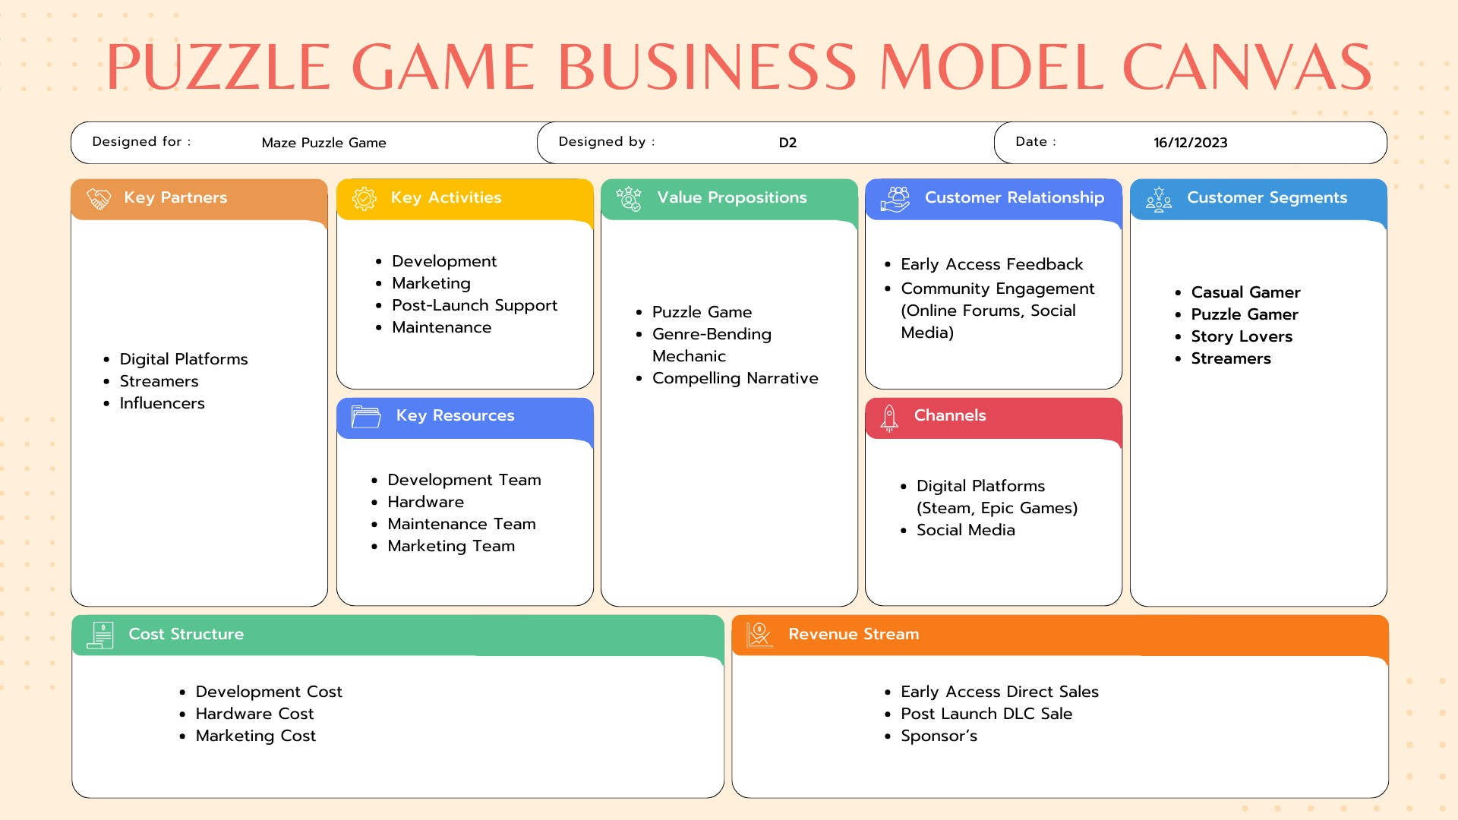
BUSINESS PLAN SOLUTIONS
PROJECT INTRODUCTION
SRS
MAZE GAME
Multi-genre Approach Broadens the Game's Appeal
iterative development model allows for continuous refinement of the game
Early Access Model Leads to Lowers Risk
Early access model is cost-efficient by Spreading Development Costs Over Time
BUSINESS PLAN
REQUIREMENTS ANALYSIS
USE CASE DIAGRAMS

Slide 13
BUSINESS MODEL CANVAS
PROJECT INTRODUCTION
SRS
MAZE GAME
BUSINESS PLAN
REQUIREMENTS ANALYSIS
USE CASE DIAGRAMS

Slide 14
BUSINESS MODEL CANVAS
PROJECT INTRODUCTION
SRS
MAZE GAME
BUSINESS PLAN
REQUIREMENTS ANALYSIS
USE CASE DIAGRAMS

Slide 15
BUSINESS MODEL CANVAS
PROJECT INTRODUCTION
SRS
MAZE GAME
BUSINESS PLAN
REQUIREMENTS ANALYSIS
USE CASE DIAGRAMS

Slide 16
BUSINESS MODEL CANVAS
PROJECT INTRODUCTION
SRS
MAZE GAME
BUSINESS PLAN
REQUIREMENTS ANALYSIS
USE CASE DIAGRAMS

Slide 17
BUSINESS MODEL CANVAS
PROJECT INTRODUCTION
SRS
MAZE GAME
BUSINESS PLAN
REQUIREMENTS ANALYSIS
USE CASE DIAGRAMS

Slide 18
BUSINESS MODEL CANVAS
PROJECT INTRODUCTION
SRS
MAZE GAME
BUSINESS PLAN
REQUIREMENTS ANALYSIS
USE CASE DIAGRAMS

Slide 19
BUSINESS MODEL CANVAS
PROJECT INTRODUCTION
SRS
MAZE GAME
BUSINESS PLAN
REQUIREMENTS ANALYSIS
USE CASE DIAGRAMS

Slide 20
BUSINESS MODEL CANVAS
PROJECT INTRODUCTION
SRS
MAZE GAME
BUSINESS PLAN
REQUIREMENTS ANALYSIS
USE CASE DIAGRAMS

Slide 21
BUSINESS MODEL CANVAS
PROJECT INTRODUCTION
SRS
MAZE GAME
BUSINESS PLAN
REQUIREMENTS ANALYSIS
USE CASE DIAGRAMS

Slide 22
BUSINESS MODEL CANVAS
PROJECT INTRODUCTION
SRS
MAZE GAME
BUSINESS PLAN
REQUIREMENTS ANALYSIS
USE CASE DIAGRAMS

Slide 23
MARKETING STRATEGIES
PROJECT INTRODUCTION
SRS
MAZE GAME
Social Media (Instagram, Twitter, Facebook)
Influencers/Streamers (Social Media, Twitch)
Articles/Blogs (Reddit, Quora)
User/Critics Reviews (Steam, Google Reviews)
Gaming Platforms (IGN, GameSpot)
BUSINESS PLAN
REQUIREMENTS ANALYSIS
USE CASE DIAGRAMS

Slide 24
MARKETING STRATEGIES
PROJECT INTRODUCTION
SRS
MAZE GAME
Social Media (Instagram, Twitter, Facebook)
Influencers/Streamers (Social Media, Twitch)
Articles/Blogs (Reddit, Quora)
User/Critics Reviews (Steam, Google Reviews)
Gaming Platforms (IGN, GameSpot)
BUSINESS PLAN
REQUIREMENTS ANALYSIS
USE CASE DIAGRAMS

Slide 25
PROJECT INTRODUCTION
SRS
MAZE GAME
BUSINESS PLAN
REQUIREMENTS ANALYSIS
USE CASE DIAGRAMS

Slide 26
ELICITATION
PROJECT INTRODUCTION
SRS
MAZE GAME
Requirements elicitation in software engineering is the process of gathering information from stakeholders and subject matter experts to understand their needs, expectations and requirements for a project.
BUSINESS PLAN
REQUIREMENTS ANALYSIS
USE CASE DIAGRAMS

Slide 27
ELICITATION
STRATEGIES
PROJECT INTRODUCTION
Interviews:
Conduct interviews with casual and potential players to gather knowledge
Competitors Analysis:
Analyzing competitors identify opportunities, gaps, and develop strategies to improve them.
Observations:
Monitoring player interactions, preferences, and engagement levels, with existing games to identify player reactions
SRS
MAZE GAME
BUSINESS PLAN
REQUIREMENTS ANALYSIS
USE CASE DIAGRAMS

Slide 28
FUNCTIONAL REQUIREMENTS
PROJECT INTRODUCTION
Genre Bending Mechanic:
A unique genre-bending mechanic that transitions between different gameplay styles or environments
Puzzle Game:
The core gameplay revolve around engaging puzzles that challenge players intellectually
Engaging Storyline:
Developing immersive narrative that captivates players, combining both narrational and environmental storytelling elements
SRS
MAZE GAME
BUSINESS PLAN
REQUIREMENTS ANALYSIS
USE CASE DIAGRAMS

Slide 29
FUNCTIONAL REQUIREMENTS
PROJECT INTRODUCTION
SRS
MAZE GAME
Varied Puzzle Types:
The Game will include a diverse range of puzzle types of multiple genres
Adaptive Difficulty:
It will incorporate an adaptive difficulty system that adjusts the complexity of puzzles based on the player's skill level
BUSINESS PLAN
REQUIREMENTS ANALYSIS
USE CASE DIAGRAMS

Slide 30
NON FUNCTIONAL REQUIREMENTS
PROJECT INTRODUCTION
Optimization (Optimized for various hardware configuration)
Performance (Meet performance standards)
Reliability (Reliable, with minimal crashes or system failures)
Player Engagement (Actively engage players throughout game )
Usability (User interface and controls should be user-friendly)
Maintainability (Code designed should ease maintenance)
Graphic Settings (Adjustable Graphic settings )
SRS
MAZE GAME
BUSINESS PLAN
REQUIREMENTS ANALYSIS
USE CASE DIAGRAMS

Slide 31
NON FUNCTIONAL REQUIREMENTS
PROJECT INTRODUCTION
Optimization (Optimized for various hardware configuration)
Performance (Meet performance standards)
Reliability (Reliable, with minimal crashes or system failures)
Player Engagement (Actively engage players throughout game )
Usability (User interface and controls should be user-friendly)
Maintainability (Code designed should ease maintenance)
Graphic Settings (Adjustable Graphic settings )
SRS
MAZE GAME
BUSINESS PLAN
REQUIREMENTS ANALYSIS
USE CASE DIAGRAMS

Slide 32
PROJECT INTRODUCTION
SRS
MAZE GAME
BUSINESS PLAN
REQUIREMENTS ANALYSIS
USE CASE DIAGRAMS

Slide 33
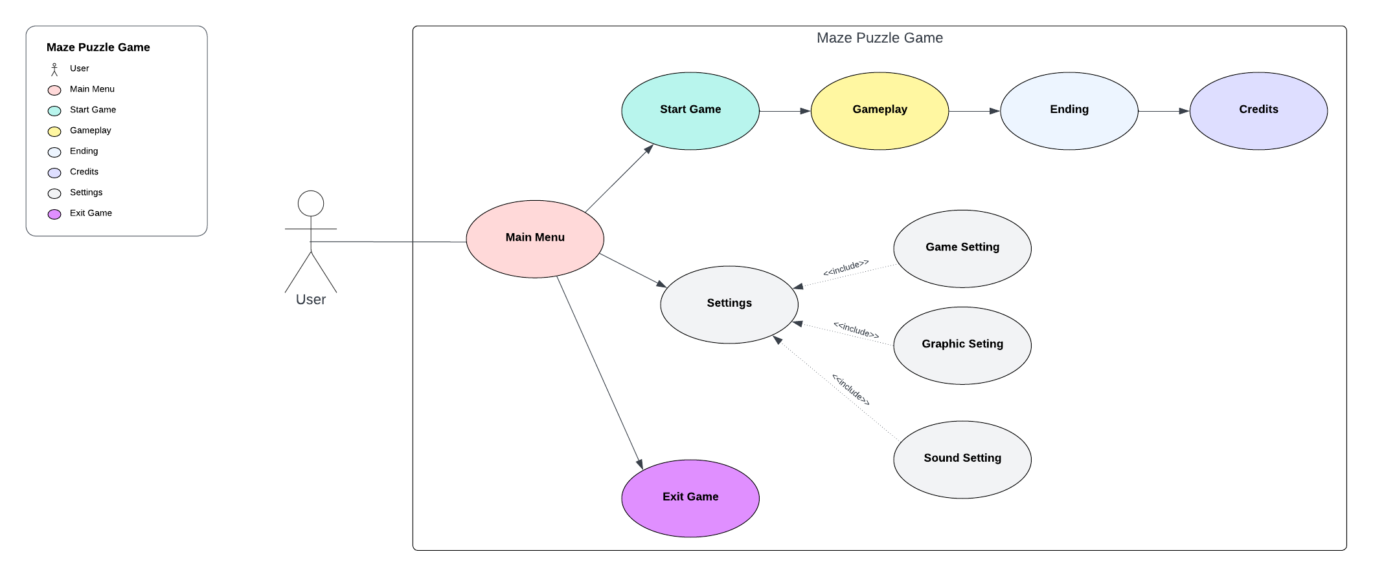
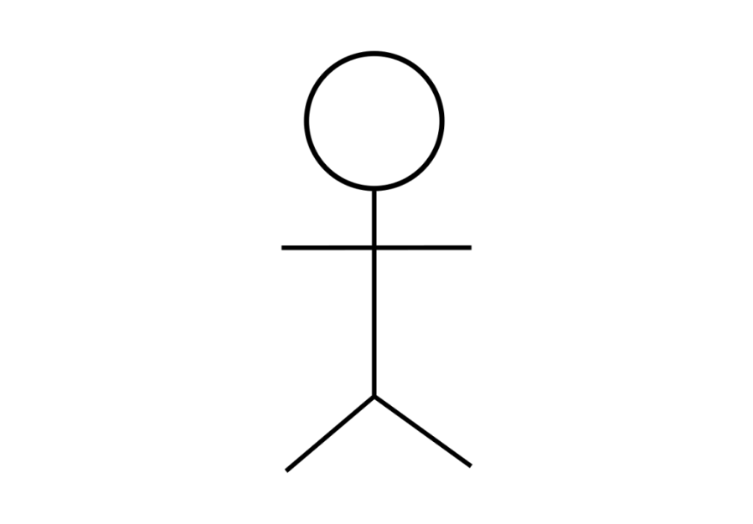
USE CASE DIAGRAM
PROJECT INTRODUCTION
Maze Puzzle Use Case
SRS
MAZE GAME
User
Main Menu
Start Game
Gameplay
Ending
Credits
Settings
Exit Game
BUSINESS PLAN
REQUIREMENTS ANALYSIS

Slide 34
USE CASE DIAGRAM
PROJECT INTRODUCTION
Maze Puzzle Use Case
SRS
MAZE GAME
User
Main Menu
Start Game
Gameplay
Ending
Credits
Settings
Exit Game
BUSINESS PLAN
REQUIREMENTS ANALYSIS

Slide 35
USE CASE DIAGRAM
PROJECT INTRODUCTION
Maze Puzzle Use Case
SRS
MAZE GAME
User
Main Menu
Start Game
Gameplay
Ending
Credits
Settings
Exit Game
BUSINESS PLAN
REQUIREMENTS ANALYSIS

Slide 36
USE CASE DIAGRAM
PROJECT INTRODUCTION
Maze Puzzle Use Case
SRS
MAZE GAME
User
Main Menu
Start Game
Gameplay
Ending
Credits
Settings
Exit Game
BUSINESS PLAN
REQUIREMENTS ANALYSIS

Slide 37
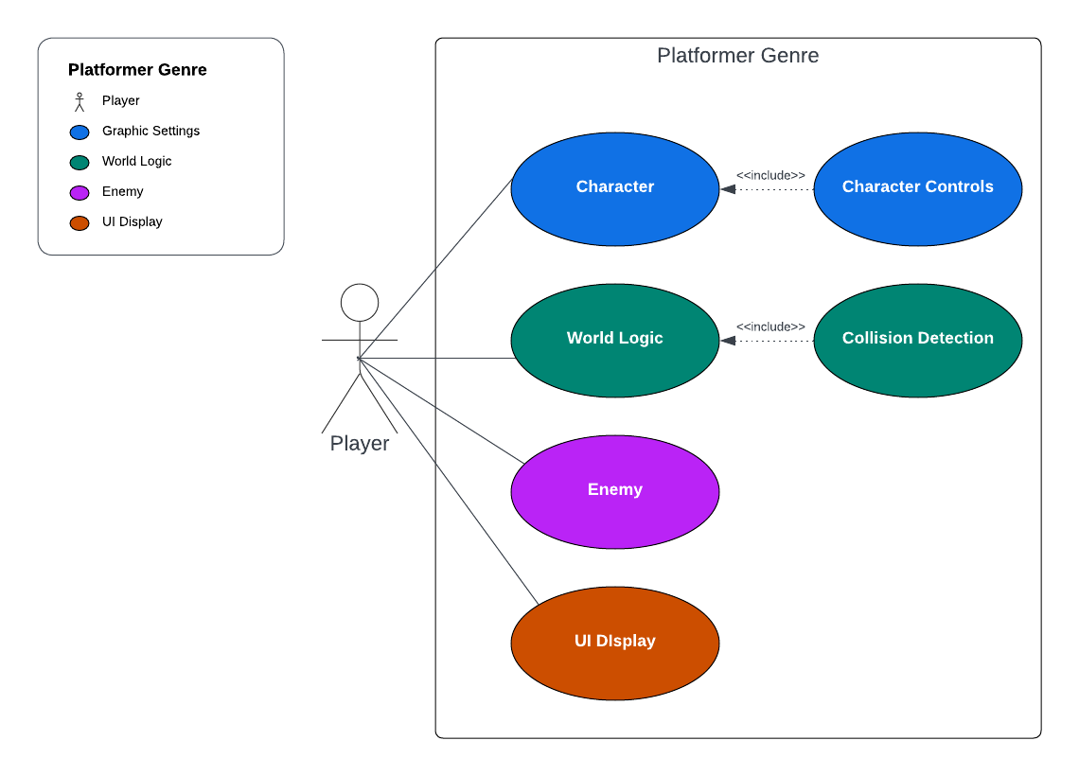
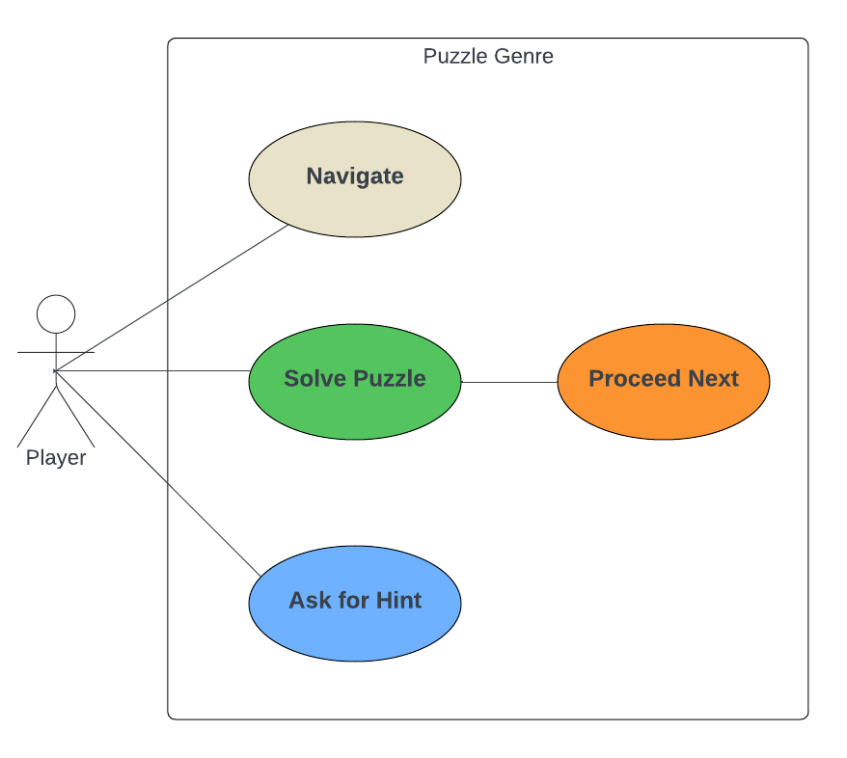
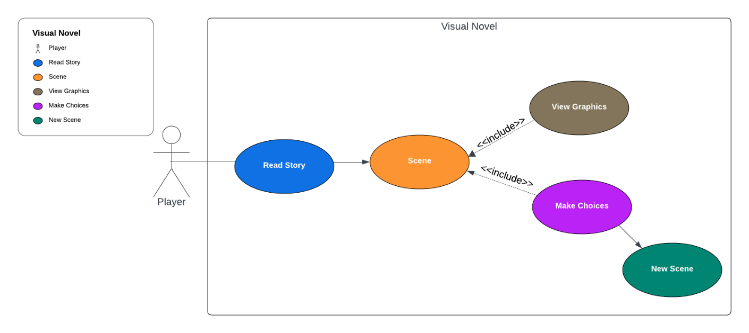
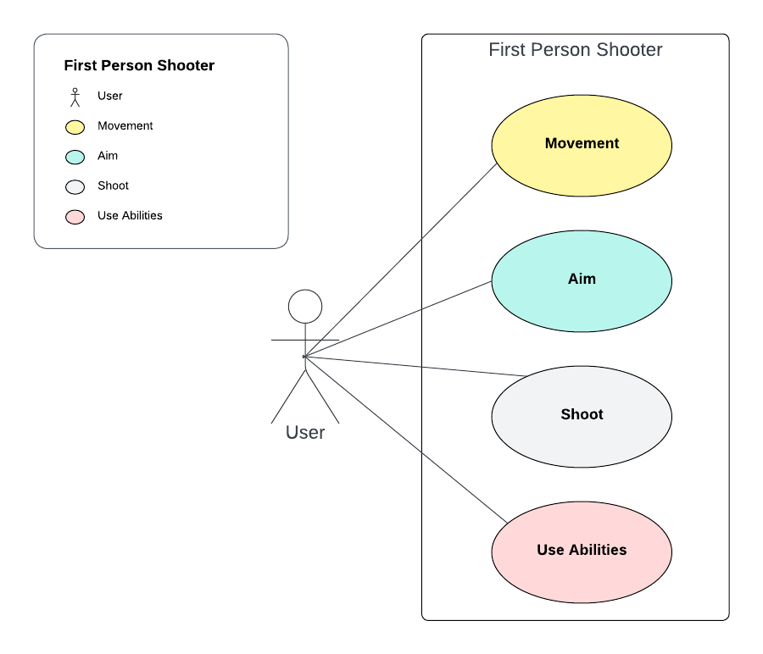
USE CASE DIAGRAM
PROJECT INTRODUCTION
Maze Puzzle Use Case
SRS
MAZE GAME
User
Main Menu
Start Game
Gameplay
Ending
Credits
Settings
Exit Game
BUSINESS PLAN
REQUIREMENTS ANALYSIS

Slide 38
USE CASE DIAGRAM
PROJECT INTRODUCTION
Maze Puzzle Use Case
SRS
MAZE GAME
User
Main Menu
Start Game
Gameplay
Ending
Credits
Settings
Exit Game
BUSINESS PLAN
REQUIREMENTS ANALYSIS

Slide 39
USE CASE DIAGRAM
PROJECT INTRODUCTION
Maze Puzzle Use Case
SRS
MAZE GAME
User
Main Menu
Start Game
Gameplay
Ending
Credits
Settings
Exit Game
BUSINESS PLAN
REQUIREMENTS ANALYSIS

Slide 40
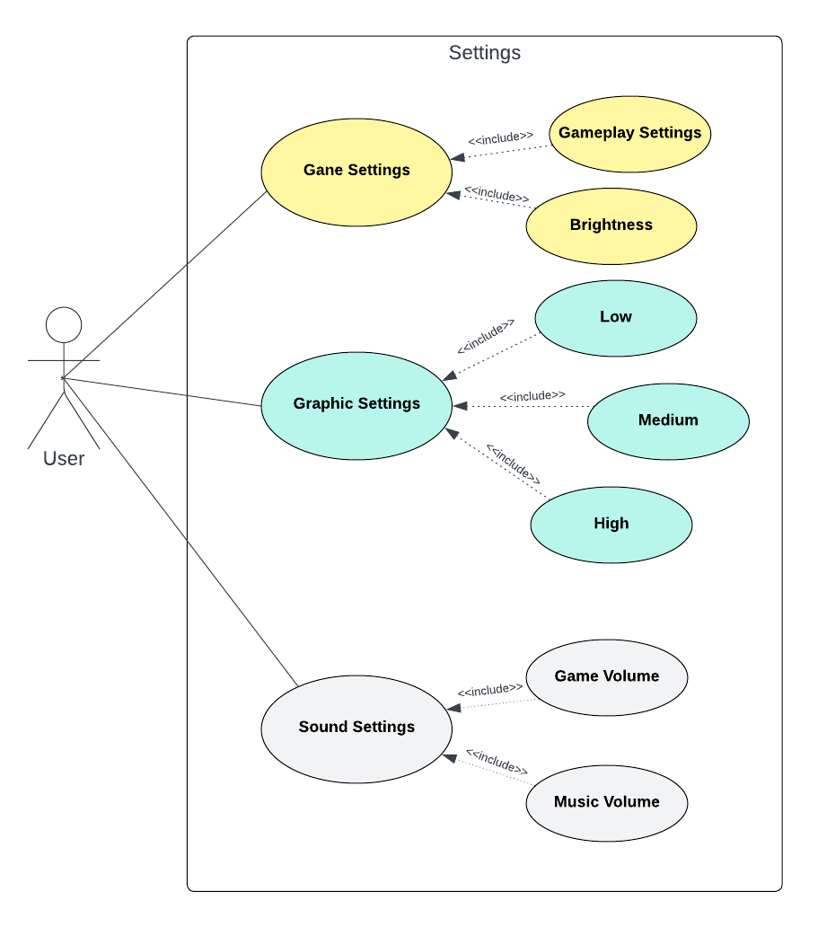
USE CASE DIAGRAM
PROJECT INTRODUCTION
Maze Puzzle Use Case
SRS
MAZE GAME
User
Main Menu
Start Game
Gameplay
Ending
Credits
Settings
Exit Game
BUSINESS PLAN
REQUIREMENTS ANALYSIS

Slide 41
USE CASE DIAGRAM
PROJECT INTRODUCTION
Maze Puzzle Use Case
SRS
MAZE GAME
User
Main Menu
Start Game
Gameplay
Ending
Credits
Settings
Exit Game
BUSINESS PLAN
REQUIREMENTS ANALYSIS

Slide 42
USE CASE DIAGRAM
PROJECT INTRODUCTION
Maze Puzzle Use Case
SRS
MAZE GAME
User
Main Menu
Start Game
Gameplay
Ending
Credits
Settings
Exit Game
BUSINESS PLAN
REQUIREMENTS ANALYSIS

Slide 43
USE CASE DIAGRAM
PROJECT INTRODUCTION
Maze Puzzle Use Case
SRS
MAZE GAME
User
Main Menu
Start Game
Gameplay
Ending
Credits
Settings
Exit Game
BUSINESS PLAN
REQUIREMENTS ANALYSIS

Slide 44
PROJECT INTRODUCTION
SRS
MAZE GAME
BUSINESS PLAN
REQUIREMENTS ANALYSIS
USE CASE DIAGRAMS

Slide 45
PROJECT INTRODUCTION
SRS
MAZE GAME
BUSINESS PLAN
REQUIREMENTS ANALYSIS
USE CASE DIAGRAMS

Slide 46


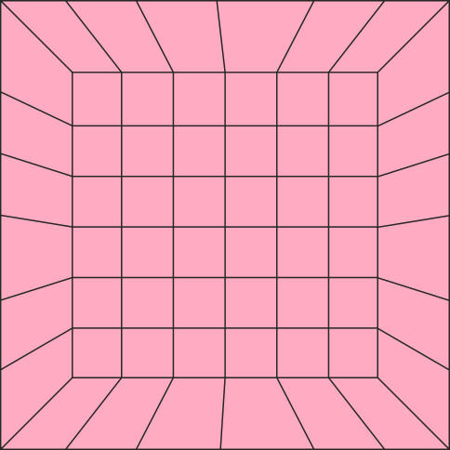






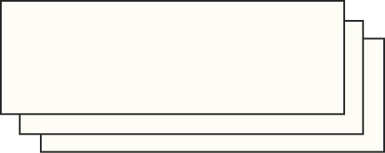

PROJECT INTRODUCTION
BUSINESS PLAN
SRS
MAZE GAME
THANK YOU!
Hope You Like Our Presentation!!!.
USE CASE DIAGRAMS
REQUIREMENTS ANALYSIS

